Slide 1

Smart Data Access for Smart Clients Using ADO.NET 2.0
Las Vegas 2005
May 9
Steven Borg
Consultant
Microsoft Certified Trainer
Author
Prerequisites for presentation:
I assume you know:
1) Visual Studio 2002|2003|2005
2) WinForms | XML Web Services | ADO.NET
Level: Intermediate
Notes:
© 2003 Microsoft Corporation. All rights reserved.
This presentation is for informational purposes only. Microsoft makes no warranties, express or implied, in this summary.
MGB 2003
Experience the Synergy: ASP.NET 2.0 and ADO.NET 2.0 _x000b_
Richard Hundhausen, Accentient
2:00 p.m.
Take part in an hour of ASP.NET 2.0 data access enlightenment! Get an introduction to the new and improved ways of building data-bound Web applications. You’ve heard all about ASP.NET 2.0’s provider model, so you won’t be surprised that ADO.NET 2.0 also defines an abstraction layer that makes all data sources look the same. We’ll learn and leverage many features of ADO.NET 2.0, such as automatic notifications to invalidate your cache. Some wizards in this session, but mostly cold, hard code!

Slide 2

Who am I?
I'm a .NET addict from Seattle, Washington
I spend my days teaching, consulting, and writing on .NET, SharePoint, and Team System
I've co-authored books on ADO.NET, XML Web Services and just finished contributing to Introducing Visual Studio Team System (MS Press)
If I’ve got any extra time, I spend it traveling, brewing beer and sailing.

Slide 3
Agenda
Smart Client Challenges
ADO.NET 2.0 Features
SQL Server 2005 Features
Smart Client Best Practices

Slide 4
Our Software
Running the February CTP 2005 (March)
  Visual Studio 2005
  SQL Server 2005
  .NET 2.0, ASP.NET 2.0, ADO.NET 2.0
  Available on Betaplace or MSDN download
Disclaimer: This presentation and all sample code are based on pre-release software.

Slide 5
Our Database
Remember the good old days of Northwind?
  Very few tables
  Very few rows
  Simple design

Slide 6
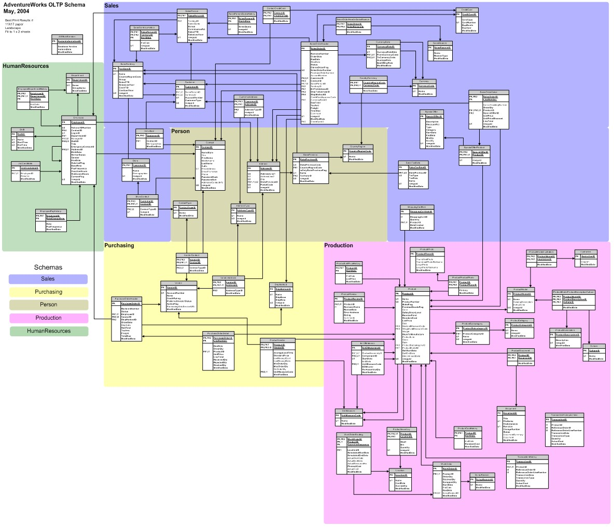
Welcome to AdventureWorks

Slide 7
Challenges of Smart Clients

Slide 8
Smart Client Benefits
Smart client applications generally have three major strengths over Web applications:
  They can run offline (execute with or without an Internet connection)
  They can have a more immersive user interface
  They can integrate with assets on the client (such as hardware and software)

Slide 9
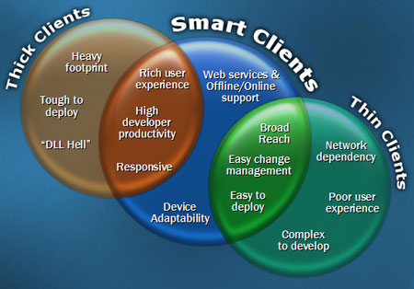
Smart Client Benefits

Slide 10
Smart Client Data Challenges
Data is generally distributed from client to server
Keeping data consistent can be a challenge
Data access latency can be an issue
Data communication must be optimized because they often run at different locations

Slide 11
Smart Client Data Solutions
ADO.NET 2.0
  ADO.NET Improvements
  Multiple Active Result Sets (MARS)
  Integrated bulk loading operations
  Asynchronous data access
SQL Server 2005
  SQL Server Improvements
  Managed Objects
  Query Notifications

Slide 12
ADO.NET 2.0

Slide 13
ADO.NET 2.0
ADO.NET Improvements
Multiple Active Result Sets (MARS)
Asynchronous data access
Integrated bulk loading operations

Slide 14
DataSet Improvements
CreateDataReader
  Similar to streaming data from a DB using DataReader
  Returns a DataTableReader with multiple result sets
  GetDataReader() is deprecated in beta 2
  // Use this to copy tables:
  myReader = myTable1.CreateDataReader()
  myTable2.Load(myReader)
Improved Insert/Delete performance
  Internal indexing scheme completely rewritten (load API)
Binary Serialization/Persistence
  ds.RemotingFormat = SerializationFormat.Binary;
  SerializeDataSet(ds, "ds.dat", SerializationFormat.Binary);
Notes:
New Indexing Engine
The indexing engine for the DataTable has been completely rewritten in ADO.NET 2.0 and scales much better for large datasets. This results in faster basic inserts, updates, and deletes, and therefore faster Fill and Merge operations. While benchmarks and quantifying performance gains is always an application-specific and often risky affair, these improvements clearly provide more than an order of magnitude improvement in loading a DataTable with a million rows. But don't take my word for it, check it out yourself, with the following simple example. Add the following code as the click event handler for a button on a Windows form:
Binary Serialization Option
The major performance improvement in loading a DataTable with a lot of data did not require us to make any change at all to our existing ADO.NET 1.x code. In order to benefit from improved performance when serializing the DataSet, we need to work a bit harder—we need to add a single line of code to set the new RemotingFormat property.
In ADO.NET 1.x, the DataSet serializes as XML, even when using the binary formatter. In ADO.NET 2.0, in addition to this behavior, we can also specify true binary serialization, by setting the RemotingFormat property to SerializationFormat.Binary rather than (the default) SerializationFormat.XML. Let us take a look at the different outputs resulting from these two different options.
In order to maintain backwards compatibility (about which the ADO.NET team was always concerned), the default value of XML serialization will give us the same behavior as in ADO.NET 1.x. The results of this serialization can be seen by running this code:
GetDataReader() is deprecated in beta 2

Slide 15
DataTable Improvements
DataTables are more independent now
  ReadXML, ReadXMLSchema
  WriteXML, WriteXMLSchema
  Load, Merge
CreateDataReader
  Returns a DataTableReader with one result set
  Don’t use GetDataReader() anymore (deprecated in Beta 2)
Notes:
New Indexing Engine
The indexing engine for the DataTable has been completely rewritten in ADO.NET 2.0 and scales much better for large datasets. This results in faster basic inserts, updates, and deletes, and therefore faster Fill and Merge operations. While benchmarks and quantifying performance gains is always an application-specific and often risky affair, these improvements clearly provide more than an order of magnitude improvement in loading a DataTable with a million rows. But don't take my word for it, check it out yourself, with the following simple example. Add the following code as the click event handler for a button on a Windows form:
Binary Serialization Option
The major performance improvement in loading a DataTable with a lot of data did not require us to make any change at all to our existing ADO.NET 1.x code. In order to benefit from improved performance when serializing the DataSet, we need to work a bit harder—we need to add a single line of code to set the new RemotingFormat property.
In ADO.NET 1.x, the DataSet serializes as XML, even when using the binary formatter. In ADO.NET 2.0, in addition to this behavior, we can also specify true binary serialization, by setting the RemotingFormat property to SerializationFormat.Binary rather than (the default) SerializationFormat.XML. Let us take a look at the different outputs resulting from these two different options.
In order to maintain backwards compatibility (about which the ADO.NET team was always concerned), the default value of XML serialization will give us the same behavior as in ADO.NET 1.x. The results of this serialization can be seen by running this code:

Slide 16
Load and Update Improvements
DataSets don't need DataAdapters to Load
  ds.Load(...)
DataTables don't need DataSets or DataAdapters
  dt.Load(...)
Batched Updates
  In ADO.NET 1.x all updates where 1 row at a time
  In ADO.NET 2.0, you set the Adapter's UpdateBatchSize
  Defaults to 1 (compatible with 1.x); 0 updates all
  adp.UpdateBatchSize = 20;
  adp.Update(dt);

Slide 17
MARS
Multiple Active ResultSets
Enables more than one pending request per connection
MARS-enabled client drivers
  SQL Native Client
  SqlClient managed provider (v2.0)
On by default; to turn it off:
Server=SRV1;Database=AdventureWorks;
Integrated Security=True;
MultipleActiveResultSets=False

Slide 18
MARS Example
...
SqlCommand cmdOuter =
new SqlCommand("SELECT * FROM Categories", myConn);
SqlDataReader rdrOuter = cmdOuter.ExecuteReader();
while (rdrOuter.Read())
{
SqlCommand cmdInner =
new SqlCommand("SELECT * FROM Products " +
"WHERE CategoryID = " +
rdrOuter["CategoryID"].ToString(), myConn);
SqlDataReader rdrInner = cmdInner.ExecuteReader();
...

Slide 19
Asynchronous ADO.NET 2.0
Three new Asynchronous methods
  BeginExecuteNonQuery
  BeginExecuteReader
  BeginExecuteXmlReader
Each has a corresponding "End" method
  EndExecuteNonQuery
  EndExecuteReader
  EndExecuteXmlReader
True async – no blocking or gimmicks

Slide 20
Asynchronous ADO.NET 2.0
SqlConnection.ConnectionString
  cnn = new SqlConnection(
  "Server=SRV1;Database=AdventureWorks;" +
  "Integrated Security=true;" +
  "Asynchronous Processing=true");
SqlCommand.BeginExecuteReader
  cmd.BeginExecuteReader(new AsyncCallback(MyCallback),
  null, CommandBehavior.CloseConnection);

Slide 21
Asynchronous ADO.NET 2.0
SqlCommand.EndExecuteReader
  private void MyCallback (IAsyncResult ar) {
  using (SqlDataReader reader =
  cmd.EndExecuteReader(ar)) {
  try {
  DataTable tbl = new DataTable();
  tbl.Load(reader);
  ... }
  catch (Exception ex) { ... }
  }

Slide 22
Integrated bulk loading operations
Fastest way to transfer data to a database
Handled by the SqlBulkCopy class
  DataSet
  DataTable
  DataReader
  XML
No support for BCP files and BCP out

Slide 23
Integrated bulk loading operations
public void LoadFromDataReader(IDataReader reader)
{
// Copy the Data to SqlServer
SqlBulkCopyOperation bcp =
new SqlBulkCopyOperation(
connectString );
bcp.DestinationTableName = "Customers";
bcp.WriteDataReaderToServer( reader );
}

Slide 24
SQL Server 2005

Slide 25
SQL Server 2005
SQL Server Improvements
Managed Objects
Query Notifications

Slide 26
SQL Server 2005 Improvements
Large Objects (LOBS)
  Stop using text, ntext, and image data types
  Start using varchar(max), nvarchar(max), and varbinary(max)
Database (DDL) Triggers
  Run code when objects get created, altered, or dropped
  Great for auditing systems where many users "help out"
DML with Output
  Ability to return rows from INSERT, UPDATE, and DELETE
  Uses the same INSERTED and DELETED model as triggers
Synonyms

Slide 27
SQL Server 2005 Improvements
XML Data Type
  Stop storing XML as text or files, use the XML data type now
  Can index, associate schema, query and modify using XQUERY
  ADO.NET 2.0 DataSet updated to support this
FOR XML Improvements
  PATH option allows full control over shape of XML returned
  Support for null values, XSD schema
Try-Catch error handling
  For those who have struggled with @@ERROR
Snapshot Isolation

Slide 28
SQL Server 2005 Managed Objects
CLR hosted inside SQL Server 2005 (SQLCLR)
Security and Isolation
What can you build?
  Managed Stored Procedures, User Defined Triggers, User Defined Functions, User Defined Types, Aggregate Functions
Visual Studio 2005 Integration

Slide 29
Query Notification
Allows you to setup a notification when data impacting a query changes
  SELECT FName, LName FROM Contact
  The notification is fired only is Contact’s First or Last name is added, deleted or changed. A change to the Contact’s address will not fire the notification.
Uses SQL Server 2005 Service Broker

Slide 30
Smart Client
Best Practices

Slide 31
Best Practices
Always use parameterized queries when working with Query Notifications
Use BatchUpdates wisely
Serialize DataTables rather than DataSets across a network
Use Binary rather than XML serialization
Cache data aggressively
Use MARS with care
Notes:
Always using parameterized queries – allows Query Notifications to be faster. (A useful internal detail to know is that SQL Server folds together notification resources for parameterized queries that use different sets of parameters. Always using parameterized queries (as shown in the SqlNotificationRequest example above) will allow you to take advantage of this and provide enhanced performance. If you are worried after hearing this, bear in mind that this performance feature does not mean that you won't get the appropriate notifications. If user1 watches authors with au_lname from A-M and user2 watches au_lname from N-Z using the au_lname values as parameters, each user will only get the "right" notifications for their subset. _

Slide 32
Best Practices
Use Bulk Load where possible
Use the Asynchronous commands in ADO.NET 2.0
Use Fill() and Merge() on the DataSet and DataTable to keep data current
Use ‘chunky’, not ‘chatty’ calls
Lazy load data to speed start-up times
Notes:
Always using parameterized queries – allows Query Notifications to be faster. (A useful internal detail to know is that SQL Server folds together notification resources for parameterized queries that use different sets of parameters. Always using parameterized queries (as shown in the SqlNotificationRequest example above) will allow you to take advantage of this and provide enhanced performance. If you are worried after hearing this, bear in mind that this performance feature does not mean that you won't get the appropriate notifications. If user1 watches authors with au_lname from A-M and user2 watches au_lname from N-Z using the au_lname values as parameters, each user will only get the "right" notifications for their subset. _

Slide 33
Resources
Websites
  http://msdn.microsoft.com/data/dataaccess/whidbey
  http://msdn.microsoft.com/asp.net/whidbey
  http://www.microsoft.com/sql/2005
Google!

Slide 34
Questions?
Steven Borg
  http://blog.accentient.com
  steve@accentient.com
Please remember to fill out your evaluation!
Thank You!

